Slide 1
NES Project – Task 2 Sprite Animations
Daniel José Febles Bustillo

Slide 2
Objectives
Preface the changes made to the code to simplify animations
Introduce the zero page as a tool for parameter storage
Describe the drawing subroutine
Explain in detail the animation subroutine and the finite-state clock it uses
Show the results of the process

Slide 3
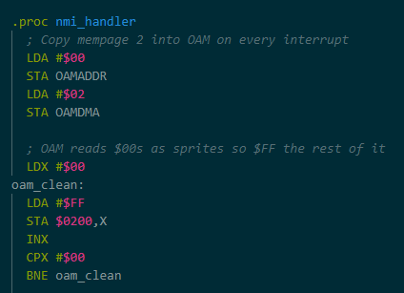

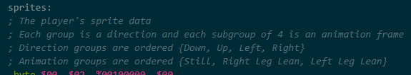
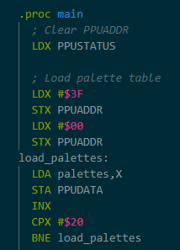
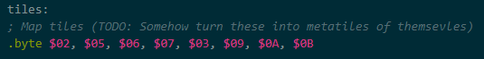
Changes to the Code
Code in main is not useful for timing since it updates way too fast
NMI interrupts update every frame, where 60 frames occur in a second
Move rendering code from main to NMI and update oam_clean
Palettes can stay in main since they are not updated constantly
Reorganize sprite table to prioritize still animation frame
Base all the sprites at zero coordinates to make offsets easier
Add a dummy sprite tile to the sideways still frame to make the number of tiles per player state uniform
Convert the two tile tables into one, in anticipation for task 4

Slide 4
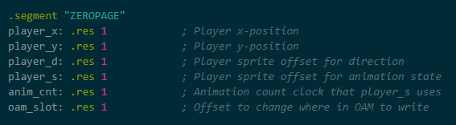
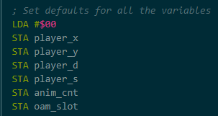
New Section: ZEROPAGE
Registers are useful, but there’s not enough of them to store everything
Memory on the zeroth page has its own addressing mode to store more variables without sacrificing too much speed
Create variables that will be used as parameters (player_x, player_y, player_d, oam_slot)
Also introduce variables for the purpose of making a clock (anim_cnt) and, eventually, a finite-state machine (player_s)
Initialize variables manually to make sure they do not contain garbage

Slide 5
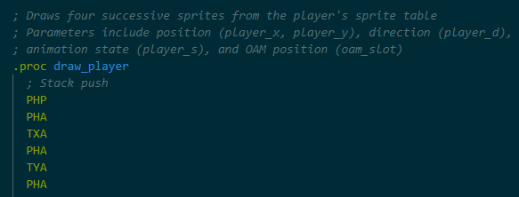
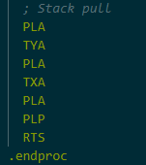
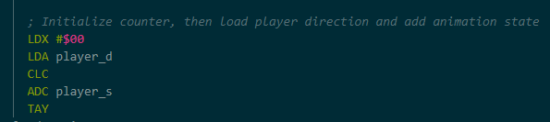
Drawing via Subroutine
With our parameters made, we can make useful subroutines
Subroutines allows the creation of pseudo functions to better organize and reuse code, without sacrificing space and legibility
Use the stack to store prior register values, including the processing register
To draw sprites, a counter is initialized, then both the direction and state parameters are combined to load the corresponding sprite data
The animation state parameters will be established by a different subroutine

Slide 6
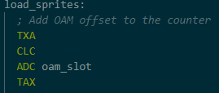
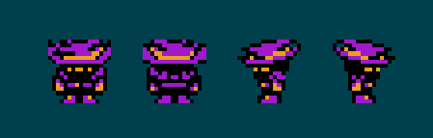
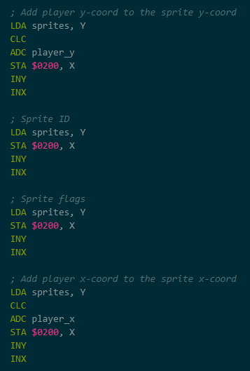
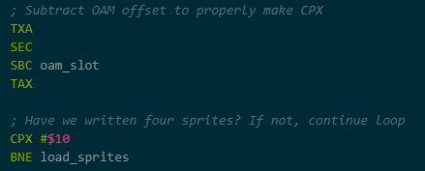
Sprite Drawing Loop
Offset the X counter with the OAM slot parameter to draw multiple player sprites at once
We write to the OAM reference page, making sure the player_x and player_y are added to their corresponding values
The sprite data uses the offset based on the animation state and the direction, while the OAM address uses the offset based on the OAM slot parameter and the counter
We subtract the OAM slot parameter every time we compare X
The loop ends when four sprites have been written, then the subroutine finishes by pulling the registers from stack and returning to main

Slide 7
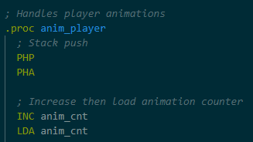
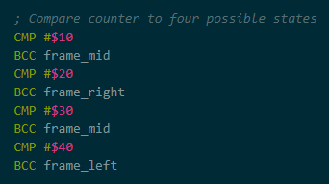
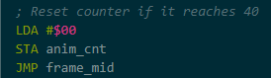
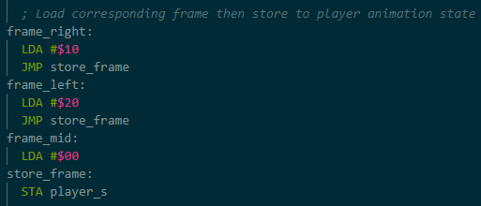
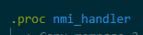
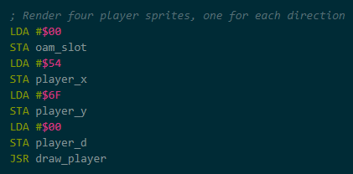
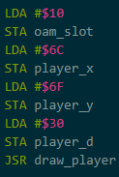
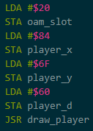
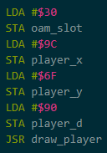
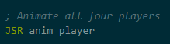
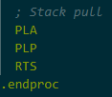
Sprite Animation
A subroutine is made to update the player’s animation state in real time
The subroutine uses a clock based on anim_cnt to update the player state
Depending on the time elapsed, it changes player_s to a given value
Once the clock gets too high, it is reset from zero and the cycle begins again
The code is called every NMI interrupt, along with draw_player

Slide 8
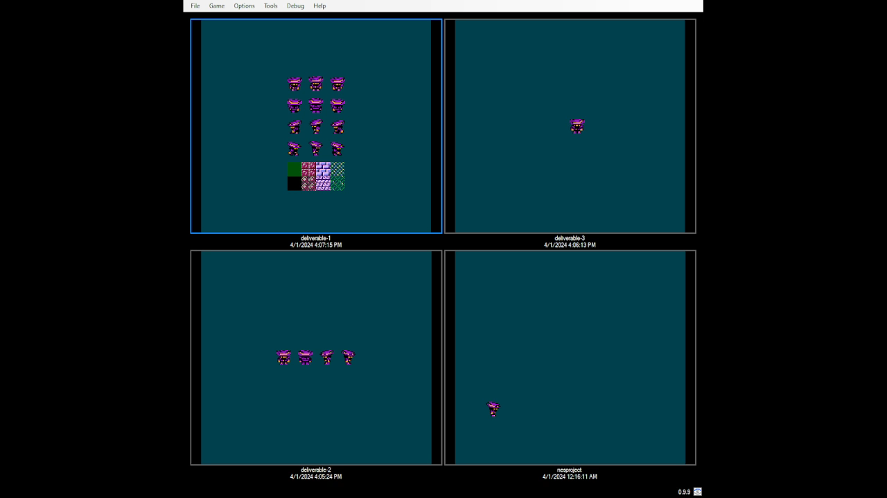
Final Result

Slide 9
Thank you for your attention

